Slide 1







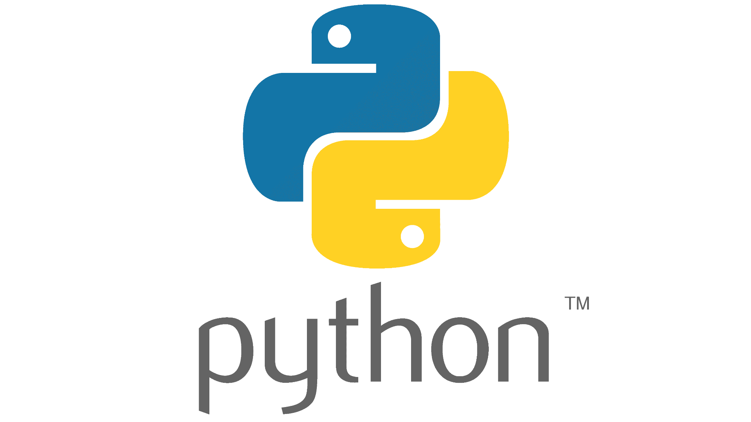
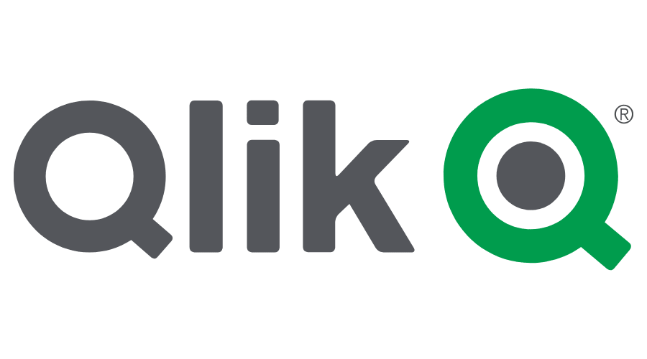



Data Consumption: Ecosystem Support
Query from any tool
Connect existing dashboards or brand new ones to the latest and freshest data, leverage your favorite tools to find new insights, and build custom data apps powered by the lakehouse with tools and languages you already know.
{REST:API}
And more…
Notes:
Connect existing BI tools and dashboards or brand new ones to the freshest data using OAuth or PAT tokens
Leverage your favorite SQL workbenches or IDE to find new insights
Build custom data apps powered by the lakehouse with tools and languages you already know

Slide 2
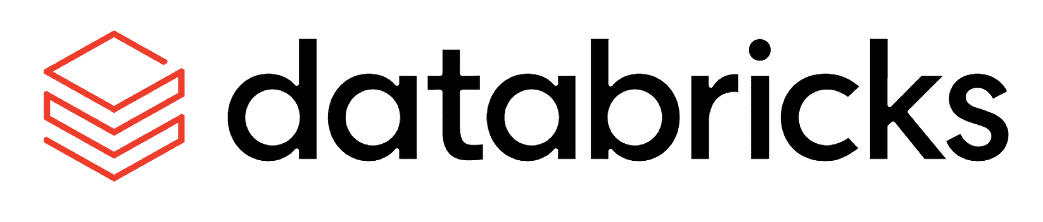

Better together: Databricks and Collibra
Unity Catalog (Lakehouse Catalog)
Enterprise Catalog and Governance
Technical metadata for data, AI, and notebooks within Databricks lakehouse
Metadata
Enrich Databricks metadata with other technical metadata and business context for all data sources and all data users
Technical lineage for assets on the Databricks lakehouse
Lineage
Harvest lineage from Databricks and non-Databricks sources and stitch together for end-to-end lineage
Govern data using policy enforcement and defining masking and row-level filtering rules for data within Databricks
Access policies
Create and manage cross-system data access policies that can be enforced across multiple clouds
Data quality
ML-based data quality
Data Quality w/Pushdown
(GA Q3 2023)
Machine learning and adaptive routines that detect and flag anomalies for remediation – across all data sources
Pre-packaged data quality routines or custom notebook development
* Collibra GA is dependent on Databricks GA
Notes:
Collibra has in the past leveraged JDBC driver to ingest technical metadata and SQL-only based lineage.
With recent Collibra releases, Collibra now integrates with Unity Catalog to ingest technical metadata.. We also have private beta of integration to retrieve technical lineage with Unity Catalog. Collibra is leveraging the Databricks lineage system table to ingest technical lineage details. Once Databricks GA’s the lineage system table Collibra will GA the technical lineage harvesting from Unity Catalog.
Collibra is under development for the integration with Collibra Protect and Unity Catalog features: column masking and row-level filtering, which are currently in Private Preview. The column masking and row filtering features of Databricks Unity Catalog are expected to move to Public Preview by the end of 2023.
Collibra Data Quality and Observability has the ability to push-down compute and execution of DQ jobs without data leaving the Databricks environment. Avoiding any customer concerns about data egress for DQ execution. This feature is currently in Beta and will GA in Q3 2023.
How does this address customers’ needs?
How does a rep map this to use cases/customer needs?
IMportant for: hybrd/multi-cloud…..
So what/who cares
WHO NEEDS THIS? (who needs to see the lineage??)
UC Catalog - catalog columns, tables, schemas, databases, including federated cloud sources – does not catalog,e.g., regulations About PHYSICAL DATA – technical user is persona. All about data.
Collibra does this too (physical stuff) - dsata + for on-prem.mukt-cloud and. WE do catalog for everything they do but for all data sources
We callbu sienss users GOVERNANCE (business context)
TEch lineage – not on DBX lakehouse – rephrase: technical lineage to capture transformation for anything that is being executed indBX Laskehouse (don’t know about ETL from :Snowflake to DBX or Oracle to dX. Dont’ knwo aout awnythign that happens on TAbleaasu.
Governance – access policies – for DBX –
Collibra does this for DBX (and SNow, GCP, AWS). They enforce policies
We are thee single point of access hwen it comes to designing policies – we desin one policy and enforce in data sources….Collibra designs poilcies and allow non-tech users to defie – nocodd etc.
All poilcies can be governed. (approvals needed –”agree on” – to do that have to have privacy, legal, data gov users collaborsating – dBCX doesn’t have platform tod do this…don’t talk about privasc y of h

Slide 3
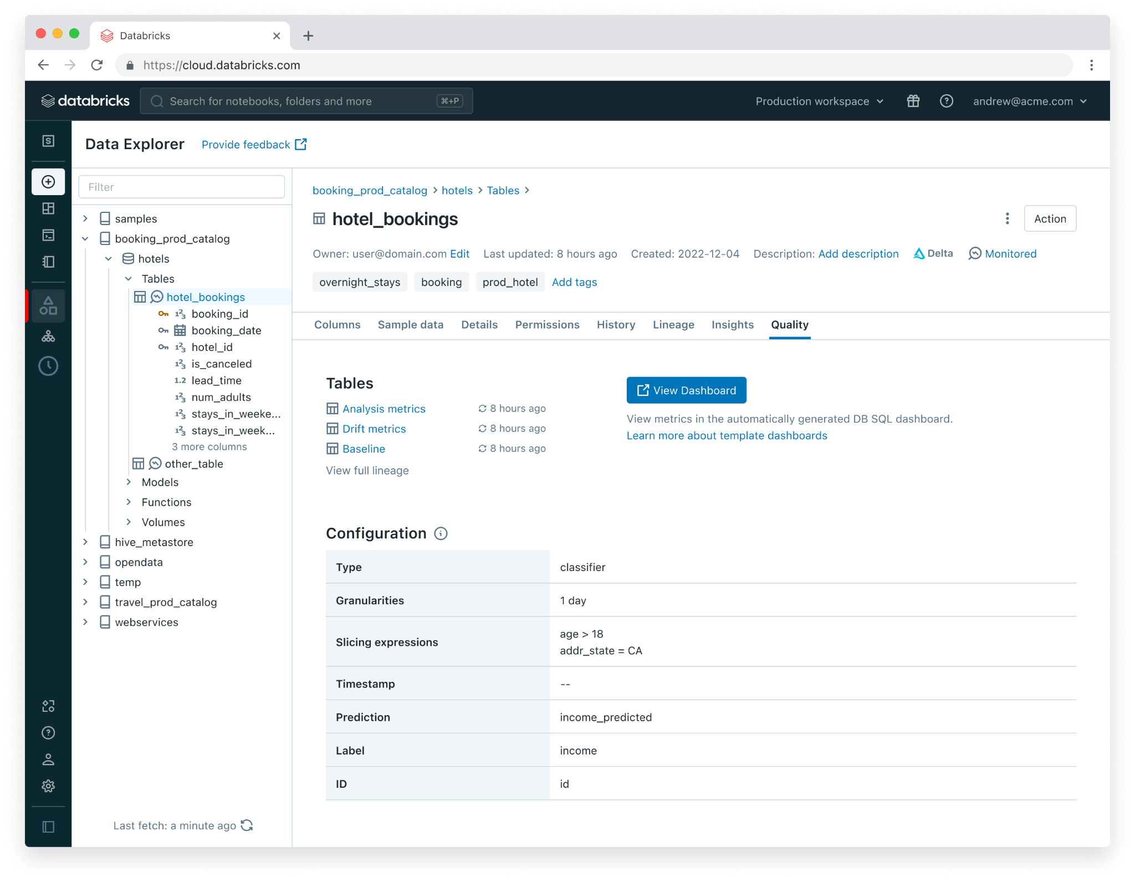
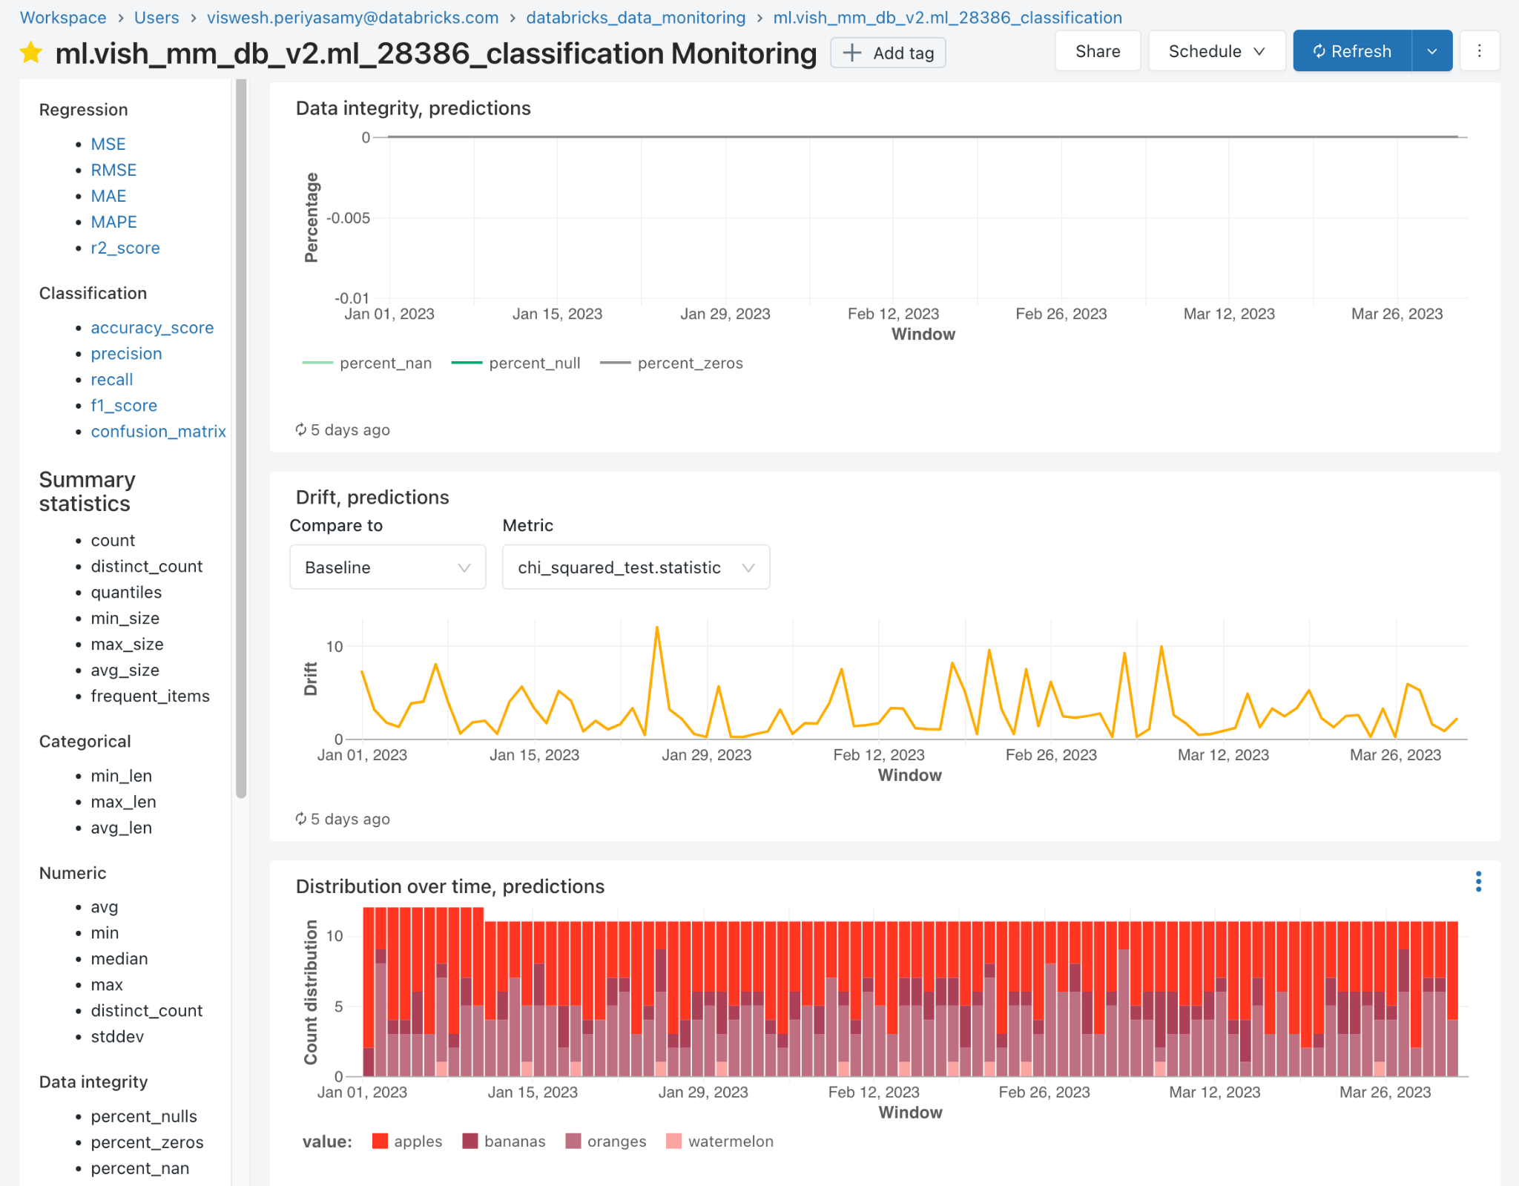
Lakehouse Monitoring
Background(scheduled) service that incrementally processes data in Unity Catalog tables:
Calculates profile metrics stored in UC table
Calculates drift metrics stored in UC table
Supports custom metrics as SQL expressions
Auto-generates DBSQL dashboard to visualize metrics over time

Slide 4
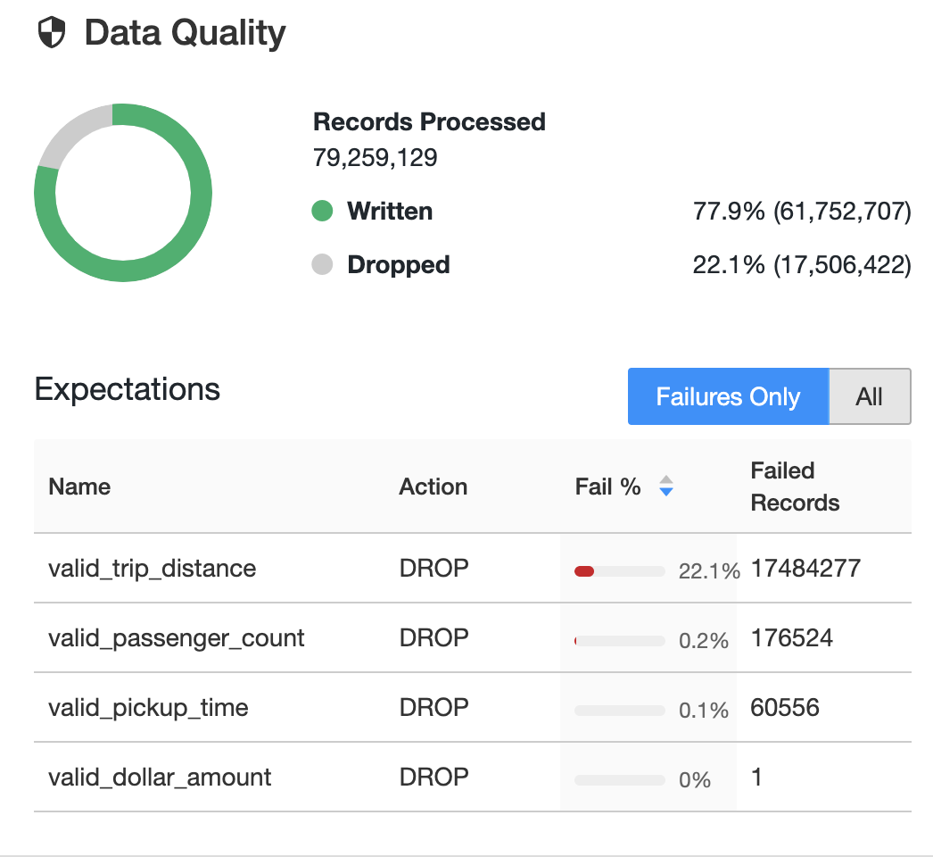
Data quality validation and monitoring
Define data quality and integrity controls within the pipeline with data expectations
Address data quality errors with flexible policies: fail, drop, alert, quarantine(future)
All data pipeline runs and quality metrics are captured, tracked and reported
/* Stage 1: Bronze Table drop invalid rows */
CREATE STREAMING LIVE TABLE fire_account_bronze AS
( CONSTRAINT valid_account_open_dt EXPECT (acconut_dt is not null and (account_close_dt > account_open_dt)) ON VIOLATION DROP ROW
COMMENT "Bronze table with valid account ids"
SELECT * FROM fire_account_raw ...
Notes:
The other reason why customers choose DLT is because of it’s differentiated data quality capabilities.
Data quality remains a huge problems for most customers who manage data pipelines.
Customers tell us that their organization suffers from low trust in their data. And data engineers struggle to quickly identify data quality issues before they make their way into reports and ML models, and when they do discover quality issues, it’s hard to correlate the problems back up to the data producer to fix data at the source.
To solve these problems, DLT includes first class support for data quality management and monitoring tools using a feature called Expectations.
Expectations helps prevent bad data from flowing into tables, lets your measure data quality, and provide tools to troubleshoot bad data.
You use expectations to define data quality constraints on the contents of a dataset. An expectation consists of a description, an invariant, and an action to take when a record fails the invariant. You apply expectations to queries using Python decorators or SQL constraint clauses.
DLT supports the ability to configure flexible policies on expectations. You are able to
Retain the row but log an error
Drop the row so it doesn’t end up in the target table
Or halt the entire pipeline. When a pipeline fails because of an expectation violation, you must fix the pipeline code to handle the invalid data correctly before re-running the pipeline.
DLT provides monitoring UIs that provide run-time statistics like number of rows process, failed, as well as metrics on a per-expectations basis. You can also look at historical performance (previous runs) with a click of a button - allowing you to track pipeline performance and data quality over time.
Some customers also use expectations as a way to do data exploration and classification of a new data set. For example your can use expectation to determine the % of values in a particular column are NULL, measure the number of invalid emails address, and more.
-----------
The other reason why customers choose DLT is because of it’s differentiated data quality capabilities. Data quality remains a huge problems for most customers who manage data pipelines.
Customers tell us that their organization suffers from low trust in their data. And data engineers struggle to quickly identify data quality issues before they make their way into reports and ML models, and when they do discover quality issues, it’s hard to correlate the problems back up to the data producer to fix data at the source.
To solve these problems, DLT includes first class support for data quality management and monitoring tools using a feature called Expectations. Expectations helps prevent bad data from flowing into tables, lets your measure data quality, and provide tools to troubleshoot bad data.
You use expectations to define data quality constraints on the contents of a dataset. An expectation consists of a description, an invariant, and an action to take when a record fails the invariant. You apply expectations to queries using Python decorators or SQL constraint clauses.
Use the expect, expect or drop, and expect or fail expectations with Python or SQL queries to define a single data quality constraint. You can define expectations with one or more data quality constraints in SQL or Python pipelines.
New, improved UIs for DLT monitoring UIs provide detailed view into the run-time stats of a DLT pipeline. Historical performance (previous runs) can be accessed with a click of a button allowing users to track pipeline performance and data quality over time.
Some customers also use expectations as a way to do data exploration and classification of a new data set. For example your can use expectation to determine the % of values in a particular column are NULL, measure the number of invalid emails address, and more.

Slide 5

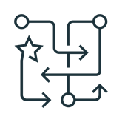


Delta Live Tables
The best way to do ETL on the lakehouse
Accelerate ETL development Declare SQL or Python and DLT automatically orchestrates the DAG, handles retries, changing data
Automatically manage your infrastructure Automates complex tedious activities like recovery, auto-scaling, and performance optimization
Ensure high data quality Deliver reliable data with built-in quality controls, testing, monitoring, and enforcement
Unify batch and streaming Get the simplicity of SQL with freshness of streaming with one unified API
CREATE STREAMING TABLE raw_data
AS SELECT *
FROM cloud_files ("/raw_data", "json")
CREATE MATERIALIZED VIEW clean_data
AS SELECT …
FROM LIVE.raw_data
Notes:
Delta Live Tables (DLT) is the first ETL framework that uses a simple declarative approach to building reliable data pipelines and automatically managing your infrastructure at scale so data analysts and engineers can spend less time on tooling and focus on getting value from data. With DLT, engineers are able to treat their data as code and apply modern software engineering best practices like testing, error handling, monitoring and documentation to deploy reliable pipelines at scale.
Accelerate ETL development:
Unlike solutions that require you to manually hand-stitch fragments of code to build end-to-end pipelines, DLT makes it possible to declaratively express entire data flows in SQL and Python.
In addition, DLT natively enables modern software engineering best practices like the ability to develop in environment(s) separate from production, the ability to easily test it before deploying, deploy and manage environments using parameterization, unit testing and documentation. As a result, you can simplify the development, testing, deployment, operations and monitoring of ETL pipelines with first-class constructs for expressing transformations, CI/CD, SLAs and quality expectations, and seamlessly handling batch and streaming in a single API.
Automatically manage infrastructure:
Sizing clusters for optimal performance given changing, unpredictable data volumes can be challenging and lead to overprovisioning. DLT automatically scales compute to meet performance SLAs by providing the user with the option to set the minimum and maximum number of instances and let DLT size up the cluster according to cluster utilization.
Error handling and recovery, and performance optimization are all handled automatically. With DLT, you can focus on data transformation instead of operations.
Data confidence:
DLT makes it easy to create trusted data sources by including first-class support for data quality management and monitoring tools using a feature called Expectations.
Expectations help prevent bad data from flowing into tables, track data quality over time, and provide tools to troubleshoot bad data with granular pipeline observability so you get a high-fidelity lineage diagram of your pipeline, track dependencies, and aggregate data quality metrics across all of your pipelines.
Simplified batch and streaming:
Unlike other products that force you to deal with streaming and batch workloads separately, DLT supports any type of data workload with a single API so data engineers and analysts alike can build cloud-scale data pipelines faster and without needing to have advanced data engineering skills.

Slide 6








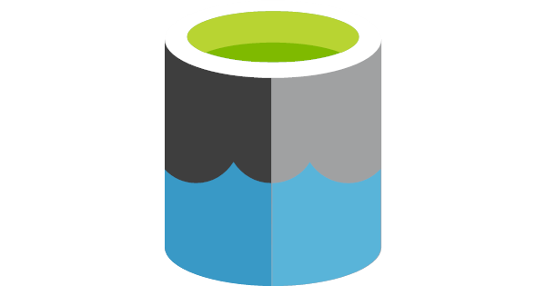
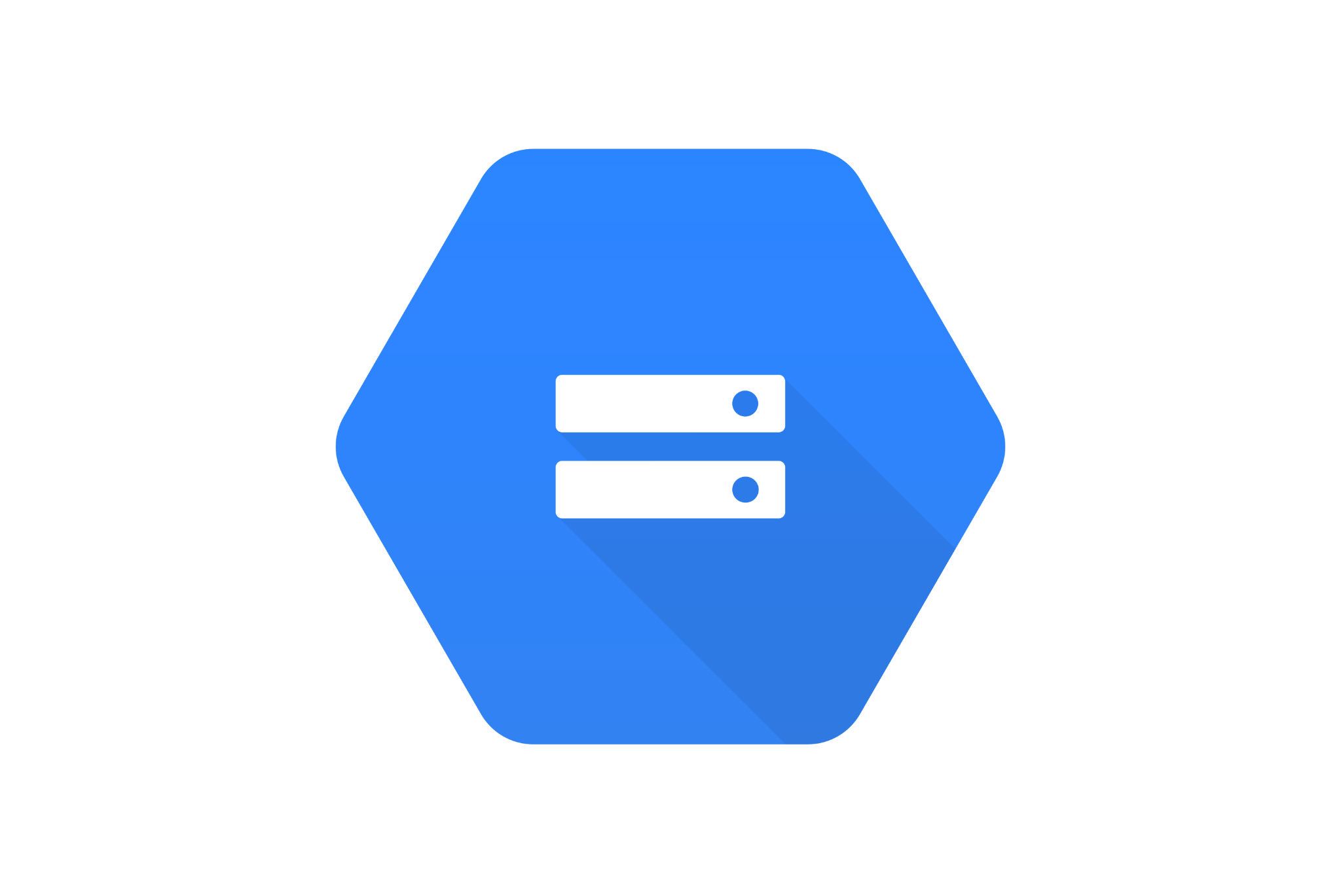

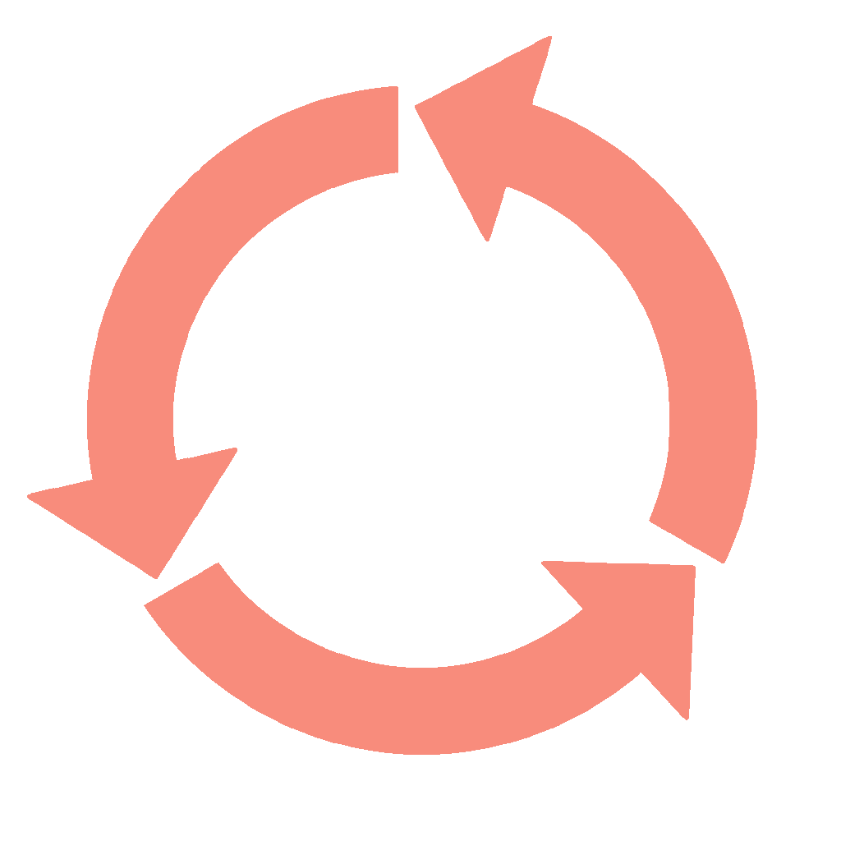


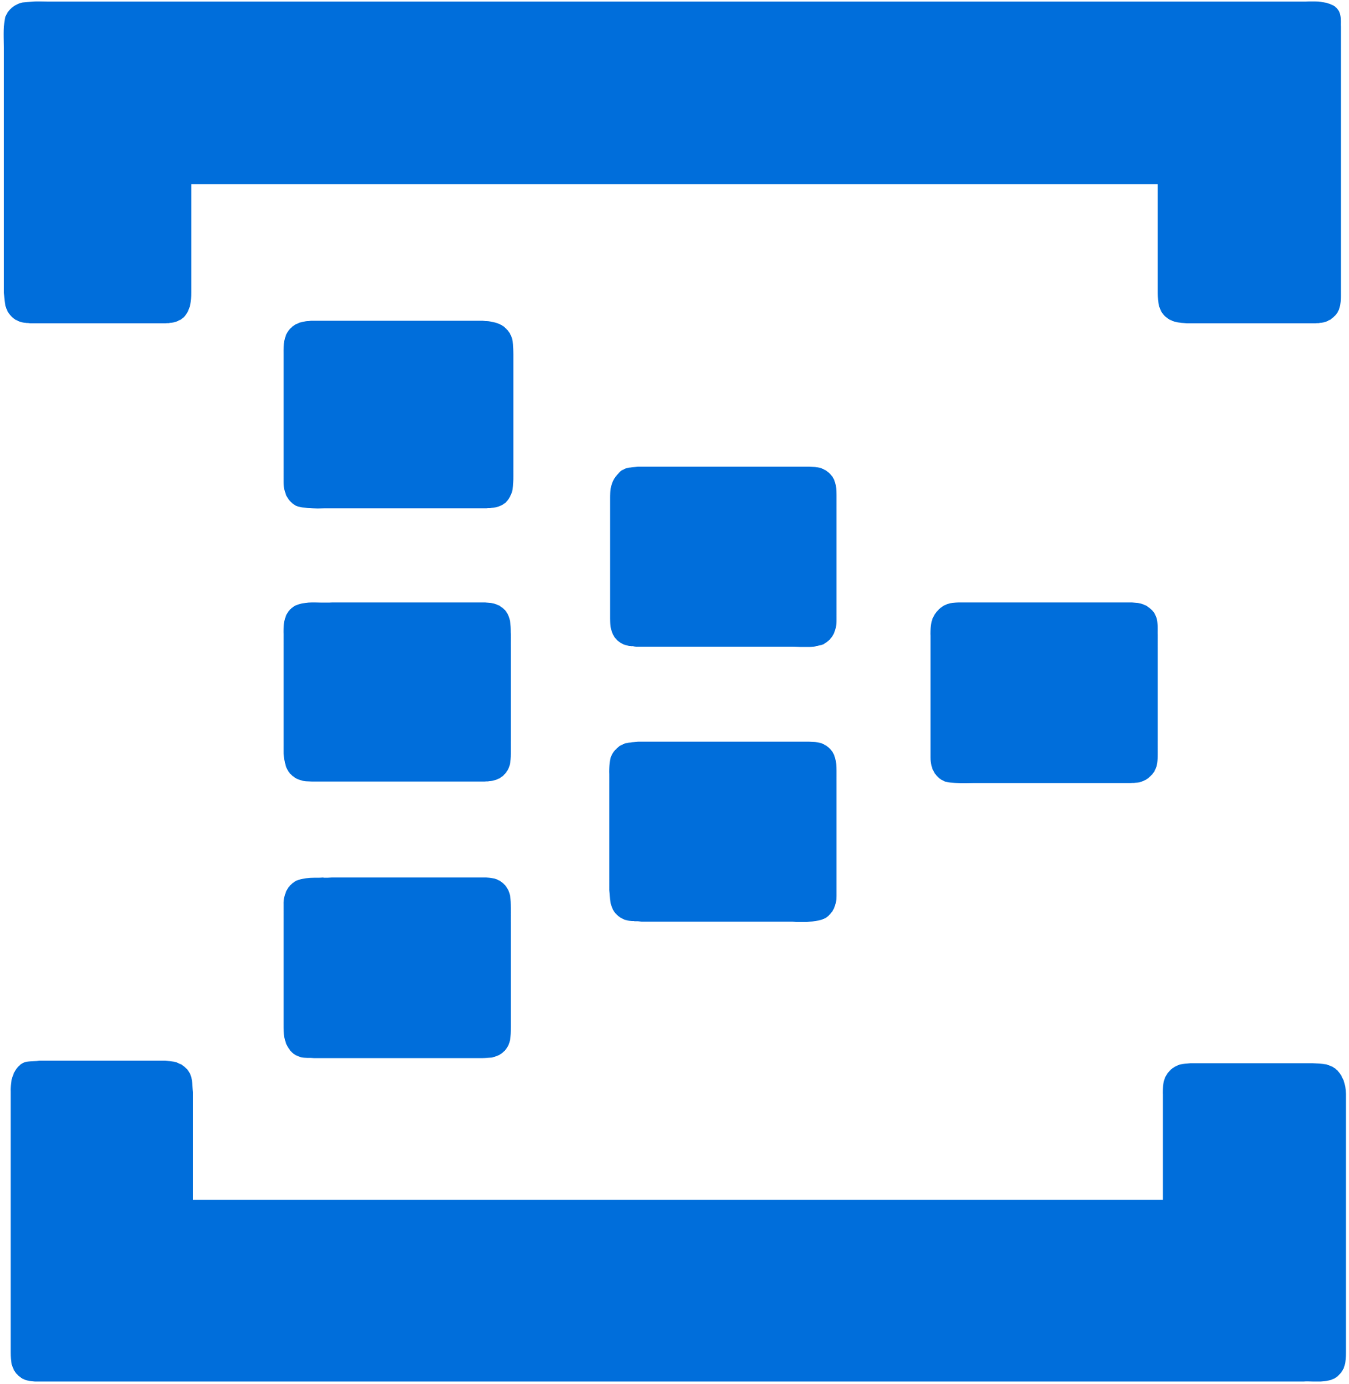


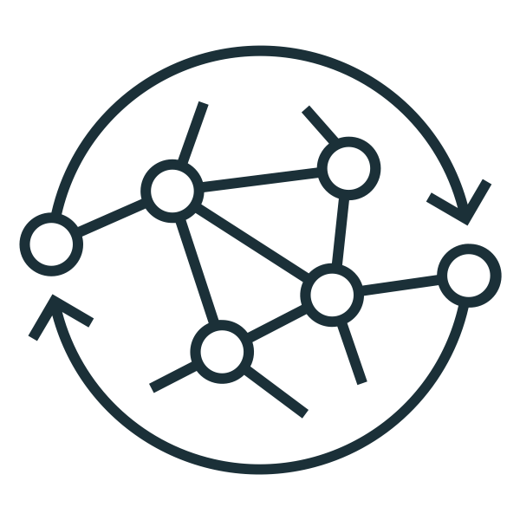




Build Production ETL Pipelines with DLT
Databricks Lakehouse Platform
Business Insights
Automatic Operations
Orchestration
Observability
Data Quality
CI / CD
Bronze Layer
Silver Layer
Gold Layer
customers
(Streaming Table)
Cloud Storage
customer_orders
(Materialized View)
daily_orders
(Materialized View)
Analytics
orders
(Streaming Table)
Message Queues
Machine Learning
Photon
UNITY CATALOG
Operational Apps
Notes:
Let’s look at how DLT allows analysts and data engineers to easily build production-ready streaming or batch ETL pipelines in SQL and Python.
DLT captures a declarative description of the full data pipelines to understand dependencies live and automate away virtually all of the inherent operational complexity.
As a result - data engineers and analysts can concentrate on writing data transformations and expressing data quality requirements, instead of worrying about operating and maintaining pipeline.
Let’s look at how:
- DLT automatically handles error handling and automatically recovering from failures without requiring user intervention.
- It provides tools to troubleshoot bad data with granular pipeline observability so you get a high-fidelity lineage diagram of your pipeline, track dependencies, and aggregate data quality metrics across all of your pipelines.
- DLT natively enables modern software engineering best practices like the ability to develop in environment(s) separate from production, the ability to easily test it before deploying, deploy and manage environments using parameterization, unit testing and documentation.
- Finally, DLT is fully integrated into Databricks Lakehouse so you can schedule pipelines with a single click, or set them to ‘continuous’ mode to automatically ingest new data as it arrives.
In the next section, we’ll dive into these capabilities more deeply.

Slide 7
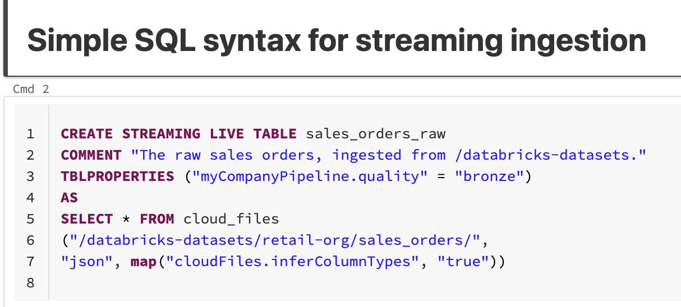
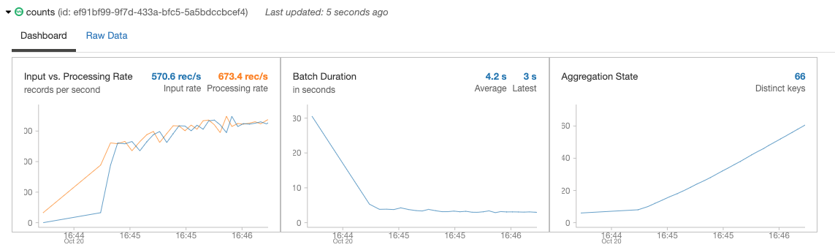
Continuous or scheduled data ingestion
Incrementally and efficiently process new data files as they arrive in cloud storage using Auto Loader
Automatically infer schema of incoming files or superimpose what you know with Schema Hints
Automatic schema evolution
Rescue data column - never lose data again
Schema Evolution
JSON
CSV
AVRO
PARQUET
✅
✅
✅
✅
Notes:
The first thing I wanted to talk about is getting data into Delta Lake. Ingesting data has to be reliable and has to scale. As volume grows, you need a way to ingest data easily, and with the ability to do change-data-capture, or CDC.
Auto Loader incrementally and efficiently processes new data files as they arrive in cloud storage. Auto Loader provides a Structured Streaming source called cloudFiles. Given an input directory path on the cloud file storage, the cloudFiles source processes new files with the option of also processing existing files in that directory.
Auto Loader can also infer schemas automatically, as well as evolve schemas dynamically by detecting the introduction of new columns to your data so you don’t have to manage the tracking and handling of schema changes yourself.
Auto Loader can also “rescue” data that was unexpected (for example, of differing data types) and set it aside so that you can choose to access it later.
Right now, schema evolution & inference is supported for JSON and CSV and Parquet data
---------------
The first thing I wanted to talk about is getting data into Delta Lake. Ingesting data has to be reliable and has to scale. As volume grows, you need a way to ingest data easily, and with the ability to do change-data-capture, or CDC.
Auto Loader incrementally and efficiently processes new data files as they arrive in cloud storage. Auto Loader provides a Structured Streaming source called cloudFiles. Given an input directory path on the cloud file storage, the cloudFiles source new files with the option of also processing existing files in that directory.
Auto Loader can also infer schemas automatically, as well as evolve schemas dynamically by detecting the introduction of new columns to your data so you don’t have to manage the tracking and handling of schema changes yourself. Auto Loader can also “rescue” data that was unexpected (for example, of differing data types) and set it aside so that you can choose to access it later.
Right now, we have support for JSON and CSV data, where you can infer the schema of all the files, as well as automatically evolve the schema of all your downstream Delta Tables. And we're bringing that same support to the data sources of PARQUET and AVRO later this year.

Slide 8
Declarative SQL & Python APIs
Source
/* Create a temp view on the accounts table */
CREATE STREAMING VIEW account_raw AS
SELECT * FROM cloud_files(“/data”, “csv”);
Use intent-driven declarative development to abstract away the “how” and define “what” to solve
Automatically generate lineage based on table dependencies across the data pipeline
Automatically checks for errors, missing dependencies and syntax errors
Bronze
/* Stage 1: Bronze Table drop invalid rows */
CREATE STREAMING TABLE account_bronze AS
COMMENT "Bronze table with valid account ids"
SELECT * FROM account_raw ...
Silver
/* Stage 2:Send rows to Silver, run validation rules */
CREATE STREAMING TABLE account_silver AS
COMMENT "Silver Accounts table with validation checks"
SELECT * FROM account_bronze ...
Gold
Notes:
While the Auto-Loader makes it easy to get data into Delta Lake,
data engineers still spend most of their time defining and writing code to manage the ETL lifecycle-- handling table dependencies, recovery, backfilling, retries or error conditions, when what they really want is to spend more time writing transformation and applying the business logic. This turns what could be a simple ETL process into a complex data pipeline implementation.
Instead of low-level hand-coding of ETL logic, data engineers leverage DLT APIs to build declarative pipelines – easily defining ‘what’ to do, not ‘how’ to do it
And DLT automatically manages all the dependencies within the pipeline. This ensures all tables are populated correctly, continuously or on a set schedule.
DLT also offer both Python and SQL APIs for Delta Live Tables. And this is particularly valuable to SQL users, because they can now start building incremental streaming pipelines, purely in SQL, while still having access to a Python and data engineering interface, where you can pull in more complex libraries and take advantage of the complexity that Python offers.
We hope that this will allow our customers to start more aggressively taking advantage of stream processing and designing their architectures with a streaming first view.
--------
While the Auto-Loader makes it easy to get data into Delta Lake, data engineers still spend most of their time defining and writing code to manage the ETL lifecycle-- handling table dependencies, recovery, backfilling, retries or error conditions, when what they really want is to spend more time writing transformation and applying the business logic. This turns what could be a simple ETL process into a complex data pipeline implementation.
That’s why we developed Delta Live Tables. DLT is a Managed Service for ETL. Instead of low-level hand-coding of ETL logic, data engineers can leverage SQL or Python to build declarative pipelines – easily defining ‘what’ to do, not ‘how’ to do it. With DLT, they specify how to transform and apply business logic, while DLT automatically manages all the dependencies within the pipeline. This ensures all tables are populated correctly, continuously or on a set schedule.
DLT also offer both Python and SQL APIs for Delta Live Tables. And this is particularly valuable to SQL users, because they can now start building incremental streaming pipelines, purely in SQL, while still having access to a Python and data engineering interface, where you can pull in more complex libraries and take advantage of the complexity that Python offers. We hope that this will allow our customers to start more aggressively taking advantage of incremental processing and designing their architectures with a streaming first view.

Slide 9

Change data capture (CDC)
Stream change records (inserts, updates, deletes) from any data source supported by DBR, cloud storage, or DBFS
Simple, declarative “APPLY CHANGES INTO” API for SQL or Python
Handles out-of-order events
Schema evolution
SCD2 support
Data Sources
Streaming Sources
Cloud Object Stores
Structured Data
Unstructured Data
Semi-
structured data
Data Migration Services
UPSERT via CDC
UPSERT via CDC
UPSERT via CDC
Bronze
Silver
Notes:
Lets talk about stream processing and change data capture
Delta Live Tables can ingest data from any data source that Databricks Runtime directly supports, any file in cloud storage such as Azure Data Lake Storage, AWS S3, or Google Cloud Storage, or any file stored in DBFS.
Change data capture are- streams of insert, update, and delete events representing incremental updates to some original table.
Now - previously - in Structured Streaming - the best solution for ingesting change data capture is the MERGE INTO command, but this has significant usability challenges, especially when the source is a streaming set of changes. A canonical example requires as many as 300 lines of complex Scala code to handle sequencing and event reconciliation. In practice, many users cannot build a fully functional solution without extensive help from Databricks field engineers.
Delta Live Tables includes functionality to make change data capture seamless. The functionality includes:
- a new, declarative API that lets users perform streaming CDC to a given target Delta table. Users can specify which row in the target should be inserted or updated by specifying a composite primary key as well as supply conditions for when to delete rows.
- Ordering is handled implicitly. Events can arrive out of order, but the final result should be the same as if they were applied in the correct order, based on a user specified sequencing column.
- We also include support for partial Updates: Some systems produce change records that contain only a subset of the fields in the target tabl, and unmodified columns are represented as NULLs. Delta Live Tables can coalesce these partial updates into a single complete / up-to-date row.
- DLT also handled schema Evolution: Users should not need to write complicated DDL to evolve the schema of the target table. Instead columns should automatically be added to the target table, even for complex / nested schemas.
Customers who have used DLT tell us that the simplicity it offers is one of the main reasons why they plan to adopt it widely in their organization.
------------------------
Delta Live Tables can ingest data from any data source that Databricks Runtime directly supports, any file in cloud storage such as Azure Data Lake Storage, AWS S3, or Google Cloud Storage, or any file stored in DBFS.
One prevalent source of incoming data is change data capture--streams of insert, update, and delete events representing incremental updates to some original table.
Now - in Structured Streaming - the best solution for ingesting change data capture is the MERGE INTO command, but this has significant usability challenges, especially when the source is a streaming set of changes. A canonical example requires as many as 300 lines of complex Scala code to handle sequencing and event reconciliation. In practice, many users cannot build a fully functional solution without extensive help from Databricks field engineers.
Delta Live Tables includes functionality to make change data capture seamless. The functionality includes:
- a new, declarative API that lets users perform streaming CDC to a given target Delta table. Users can specify which row in the target should be inserted or updated by specifying a composite primary key as well as supply conditions for when to delete rows.
- Ordering is handled implicitly. Events can arrive out of order, but the final result should be the same as if they were applied in the correct order, based on a user specified sequencing column.
- We also include support for partial Updates: Some systems produce change records that contain only a subset of the fields in the target table. Unmodified columns are either null or are not present in a given source. Delta Live Tables can coalesce these partial updates into a single complete / up-to-date row.
- DLT also handled schema Evolution: Users should not need to write complicated DDL to evolve the schema of the target table. Instead columns should automatically be added to the target table, even for complex / nested schemas.
Customers who have used DLT tell us that the simplicity it offers is one of the main reasons why they plan to adopt it widely in their organization.

Slide 10
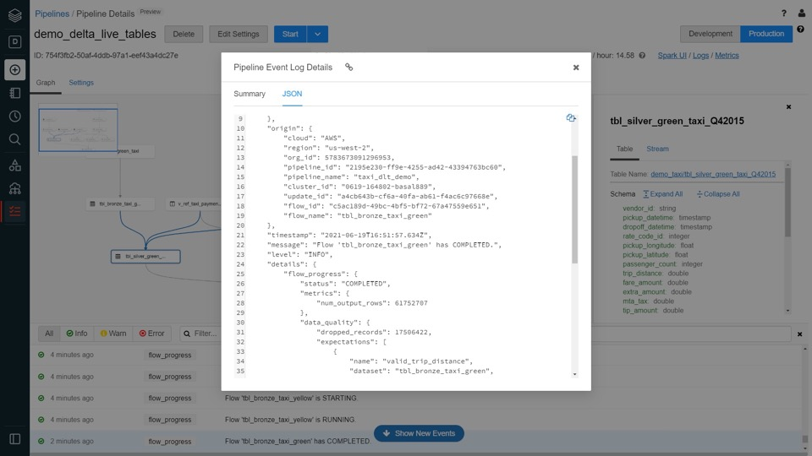
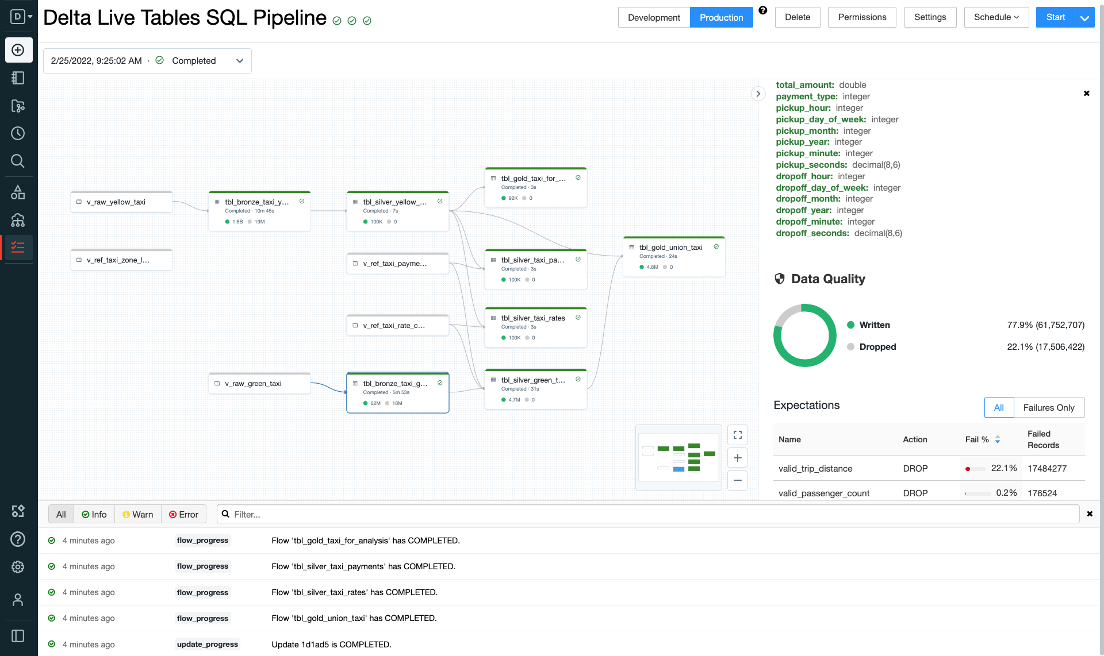
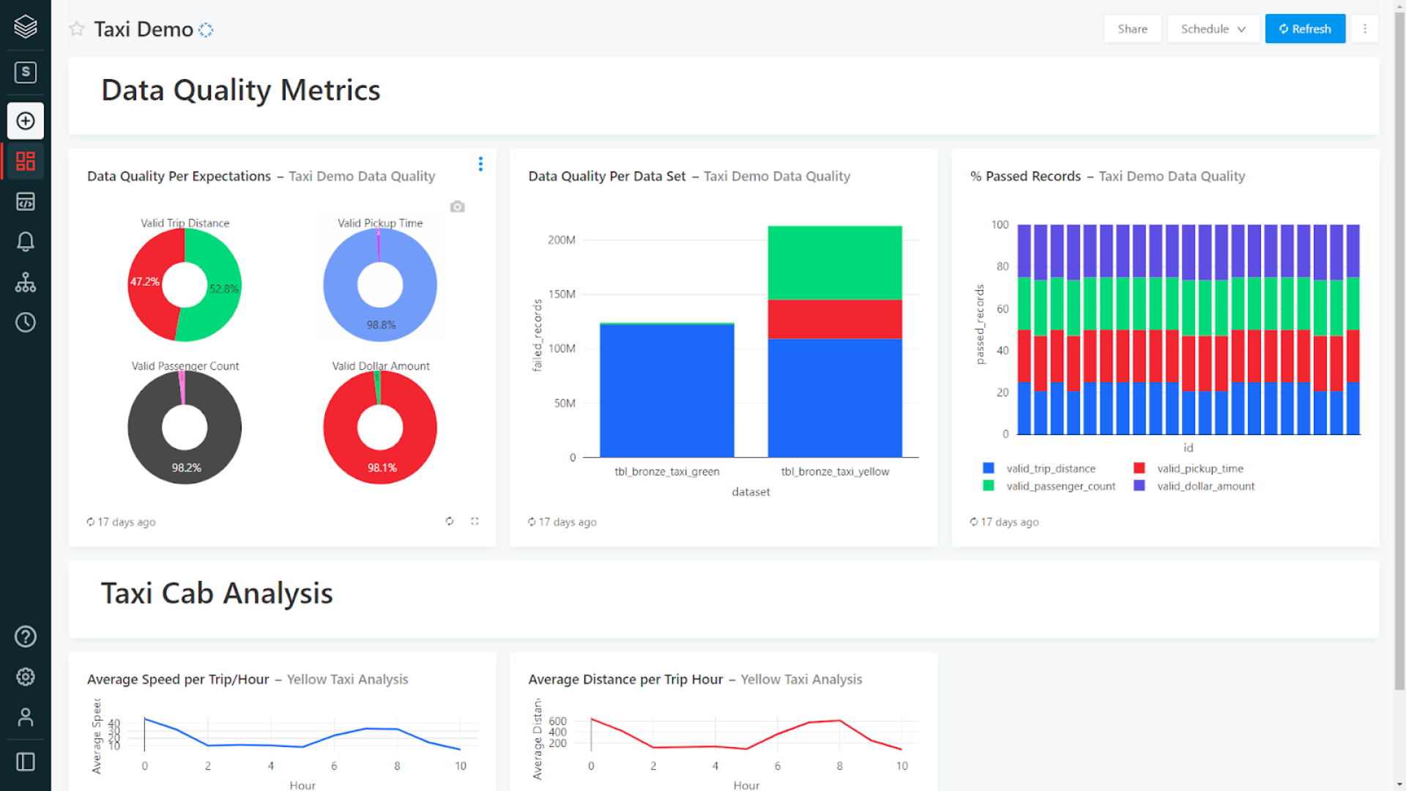
Data pipeline observability
High-quality, high-fidelity lineage diagram that provides visibility into how data flows for impact analysis
Granular logging for operational, governance, quality and status of the data pipeline at a row level
Continuously monitor data pipeline jobs to ensure continued operation
Notifications using Databricks SQL
Notes:
In addition to providing tools to track and enforce data quality at the table level, Delta Live Tables provides powerful pipeline observability
so you get a high-fidelity lineage diagram of your pipeline, track dependencies, and aggregate data quality metrics across all of your pipelines.
DLT emits all pipeline logs to a predefined Delta Lake table in the pipeline’s Storage Location, which can be used for monitoring, lineage, and data quality reporting. Because DLT logs are exposed as a Delta table, and the log contains data expectation metrics, it is easy to generate reports to monitor data quality with your BI tool of choice.
For example you can calculate metrics on the percentage of failures, number of rows processed, and more.
In addition to metrics, the logs include information to manage data governance including 1/ logging of all the operations in the pipeline and 2/ dependencies between pipelines and tables.
To query and visualize the event log, we recommend using Databricks SQL as it is tightly integrated with Delta and the Databricks platform and provides extremely fast query speeds via easy to manage compute endpoints.
You can also set up simple email alerts on data quality metrics with Databricks SQL -- for example you can be alerted when the % of failed rows in a particular table exceeds a use-defined threshold. Over time we will enhance ways to notify you of issues and also integrate with your favorite operational monitoring tools.
---------
In addition to providing tools to track and enforce data quality at the table level, Delta Live Tables provides powerful pipeline observability so you get a high-fidelity lineage diagram of your pipeline, track dependencies, and aggregate data quality metrics across all of your pipelines.
To make this work: DLT emits all pipeline logs to a predefined Delta Lake table in the pipeline’s Storage Location, which can be used for monitoring, lineage, and data quality reporting. Because DLT logs are exposed as a Delta table, and the log contains data expectation metrics, it is easy to generate reports to monitor data quality with your BI tool of choice. For example you can calculate metrics on the percentage of failures, number of rows processed, and more. In addition to metrics, the logs include information to manage data governance including 1/ logging of all the operations in the pipeline and 2/ dependencies between pipelines and tables.
To query and visualize the event log, we recommend using Databricks SQL as it is tightly integrated with Delta and the Databricks platform and provides extremely fast query speeds via easy to manage compute endpoints. With Databricks SQL, you can also set up simple email alerts on data quality metrics, so for example you can be alerted when the % of failed rows in a particular table exceeds a use-defined threshold. Over time we will certainly build in better ways to notify you of issues and also integrate with your favorite operational monitoring tools.

Slide 11
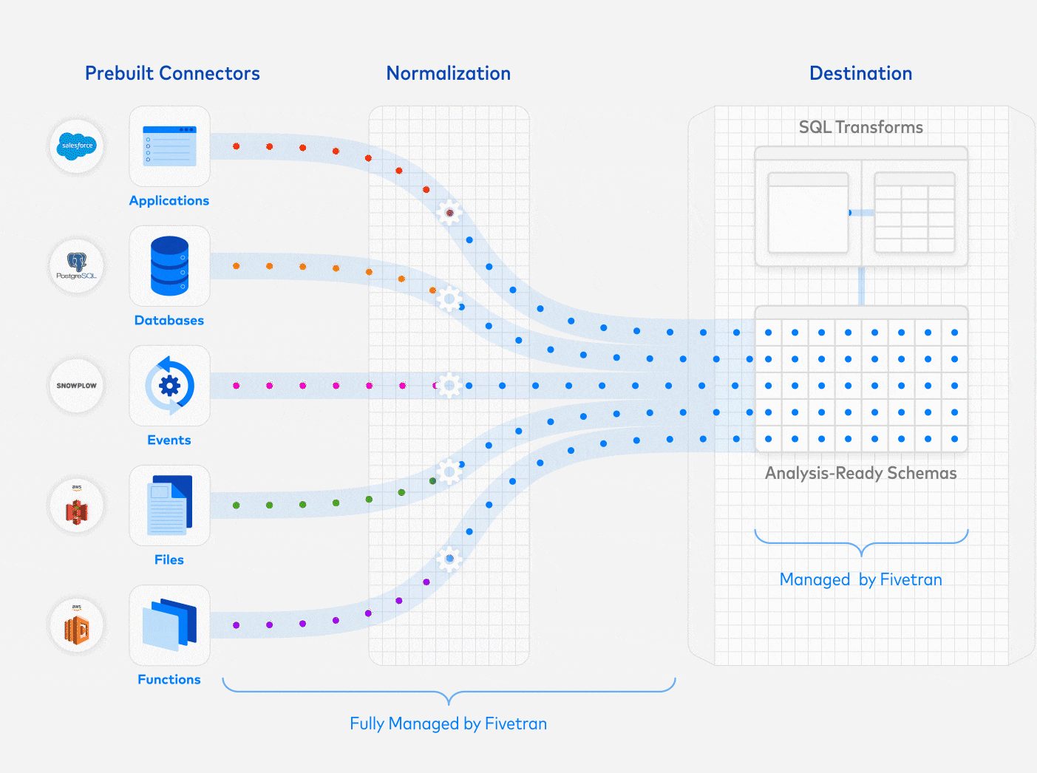

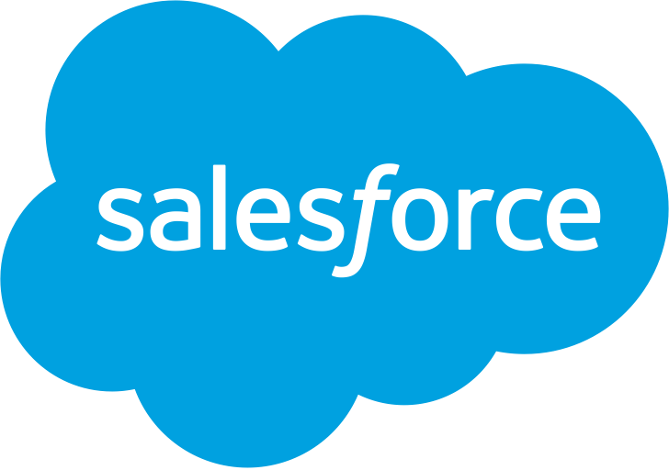


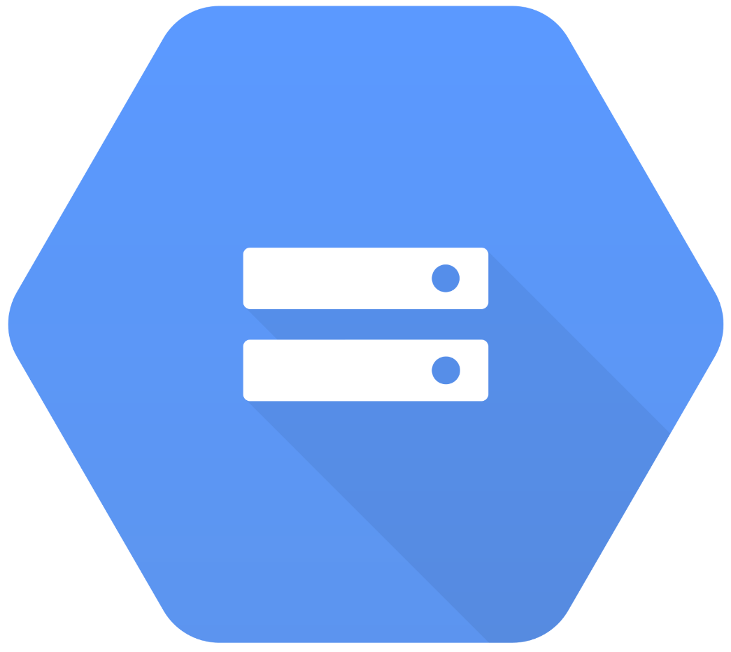


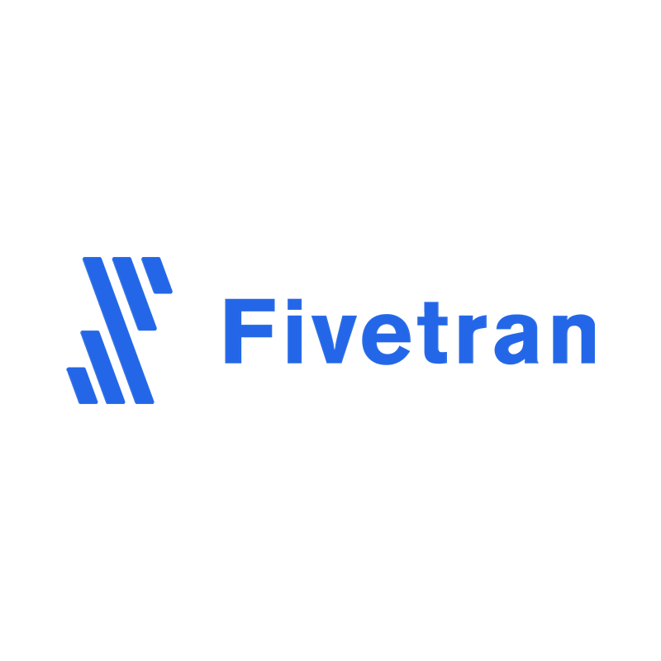
Fivetran is the standard for data movement.
What makes Fivetran unique:
Fully Automated &
Fully Managed Connectors
Normalization
No-code, self-serve, connect in minutes
Simplified & standardized architecture
ELT approach is the way
400+ connectors (multiple categories)
Multiple deployment options from Saas to Private Deployment
Centralized global security & governance
Reduced complexity = reduced costs, duplication and errors
Quickstart Data Models
Applications
Databases
Events
Analysis-Ready Schemas
Files
Trusted, useable, organized, and understandable data
Functions
Sources:
Cloud or on-prem

Slide 12
Publish layer on Databricks
Summary & User Journey: Users will be given access to a dedicated workspace that is connected to the same UC metastore as the core platform; Users can utilize notebooks, SQL editor, Workflows to build their own new tables, views or other types of objects, in their own schemas;
Pros:
Data stays in the cloud storage & can easily be reused by other stakeholders, incl. In ML applications
UC governance applies
Secure, dedicated workspace
Unification of tools, assets & governance on a single platform
Complete coverage for all types of use cases - DS/ML/AI, DE, BI
Cons:
Users need to be onboarded to Databricks
Migration / training time

Slide 13

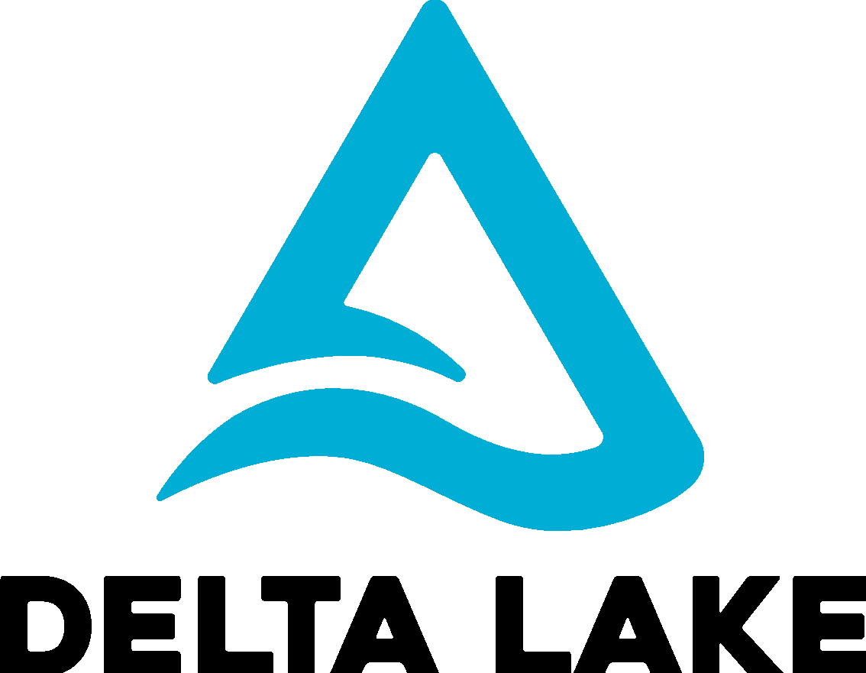
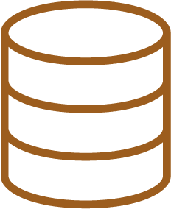
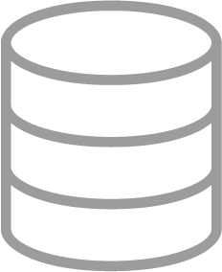
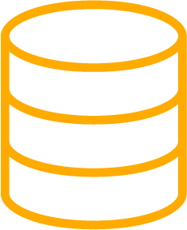
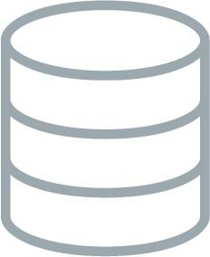
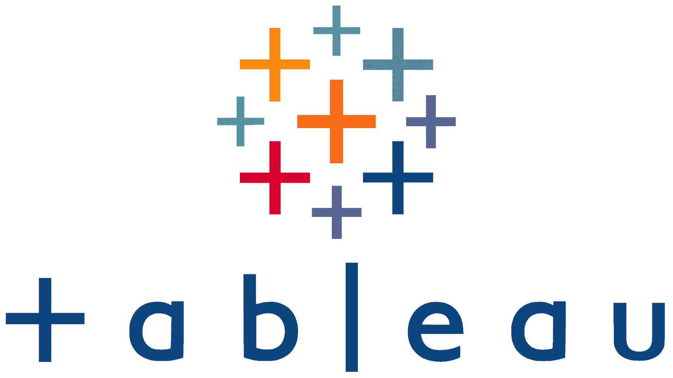




Publish layer on Databricks
Architecture
Business specific Databricks implementation
Databricks Notebooks, Delta Live Tables
Databricks Notebooks, Delta Live Tables
Data Science and Machine Learning
Curated Data
Curated Data
Databricks Machine Learning
BRONZE
SILVER
GOLD
GOLD++ / PLATINUM
DBSQL Warehouse
Enterprise Reporting and BI
Raw Ingestion and History
Filtered, Cleaned, Augmented
Business Aggregates & Data Models
Business pecific Catalog(s) & Schemas
Databricks SQL
Shared UC Metastore

Slide 14
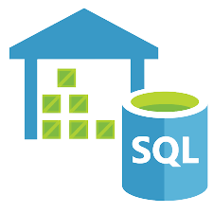
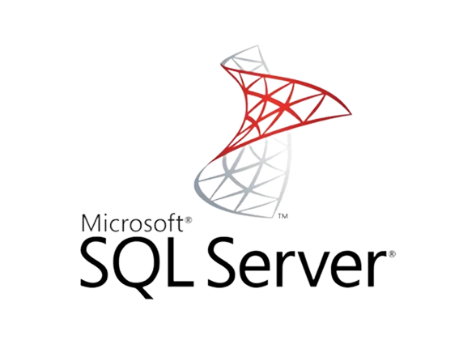





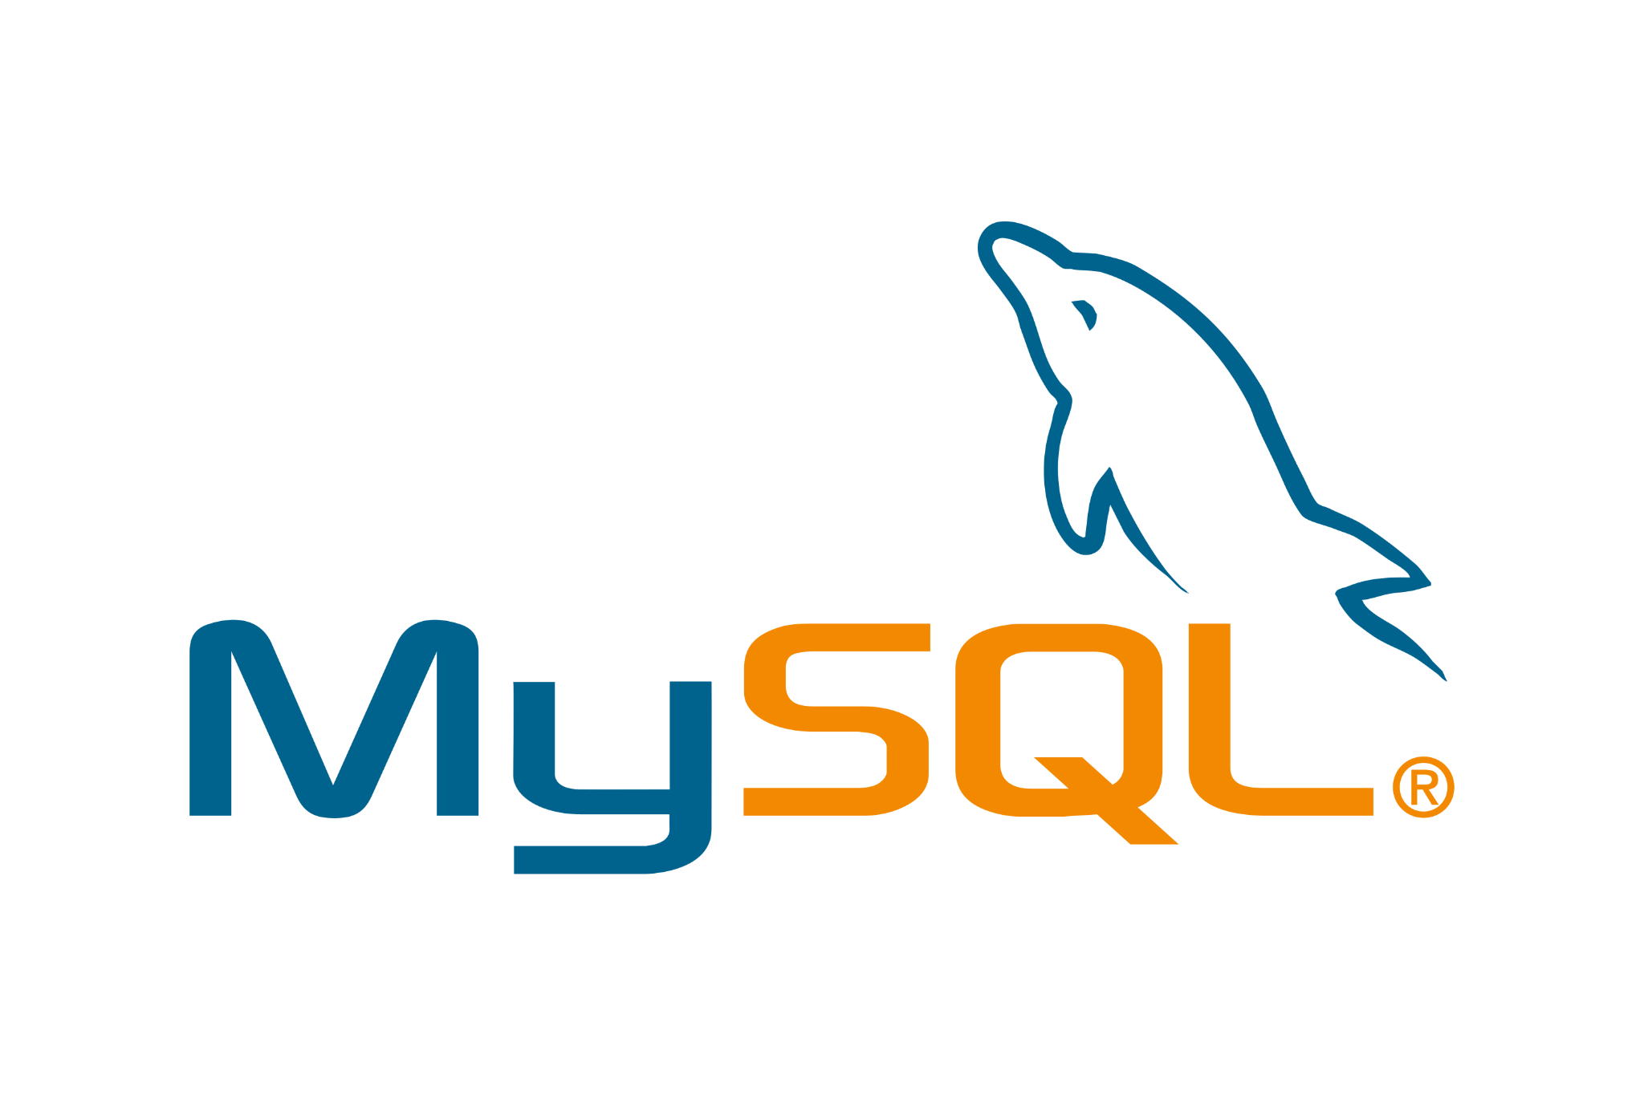
Lakehouse Federation
Discover, query, and govern all your data - no matter where it lives
Unified view into all your data
Unified engine for all your data and use cases
Unified governance across all data sources
Users
Dashboards
Notes:
Lakehouse Federation addresses these critical pain points and makes it simple for organizations to expose, query, and govern siloed data systems as an extension of their lakehouse. With these new capabilities now you will get:
A unified view of your data estate: Automatically classify and discover all your data, structured and unstructured, in one place and enable everyone in your organization to securely access and explore all the data available at their fingertips - no matter where it lives.
A unified engine for all your data and use cases: Query and combine all data efficiently with a single engine, and accelerate ad-hoc analysis and prototyping across all your data, analytics and AI use cases on the most complete data - no ingestion required. Advanced query planning across sources and caching ensure optimal query performance even when accessing and combining data from multiple platforms with a single query.
A unified governance model across all data sources: Use one permission model to set and apply access rules, and safeguard all your data across data sources. Apply rules like row and column level security, tag based policies, centralized auditing consistently across platforms, track data usage, and meet compliance requirements with built-in data lineage and auditability.

Slide 15
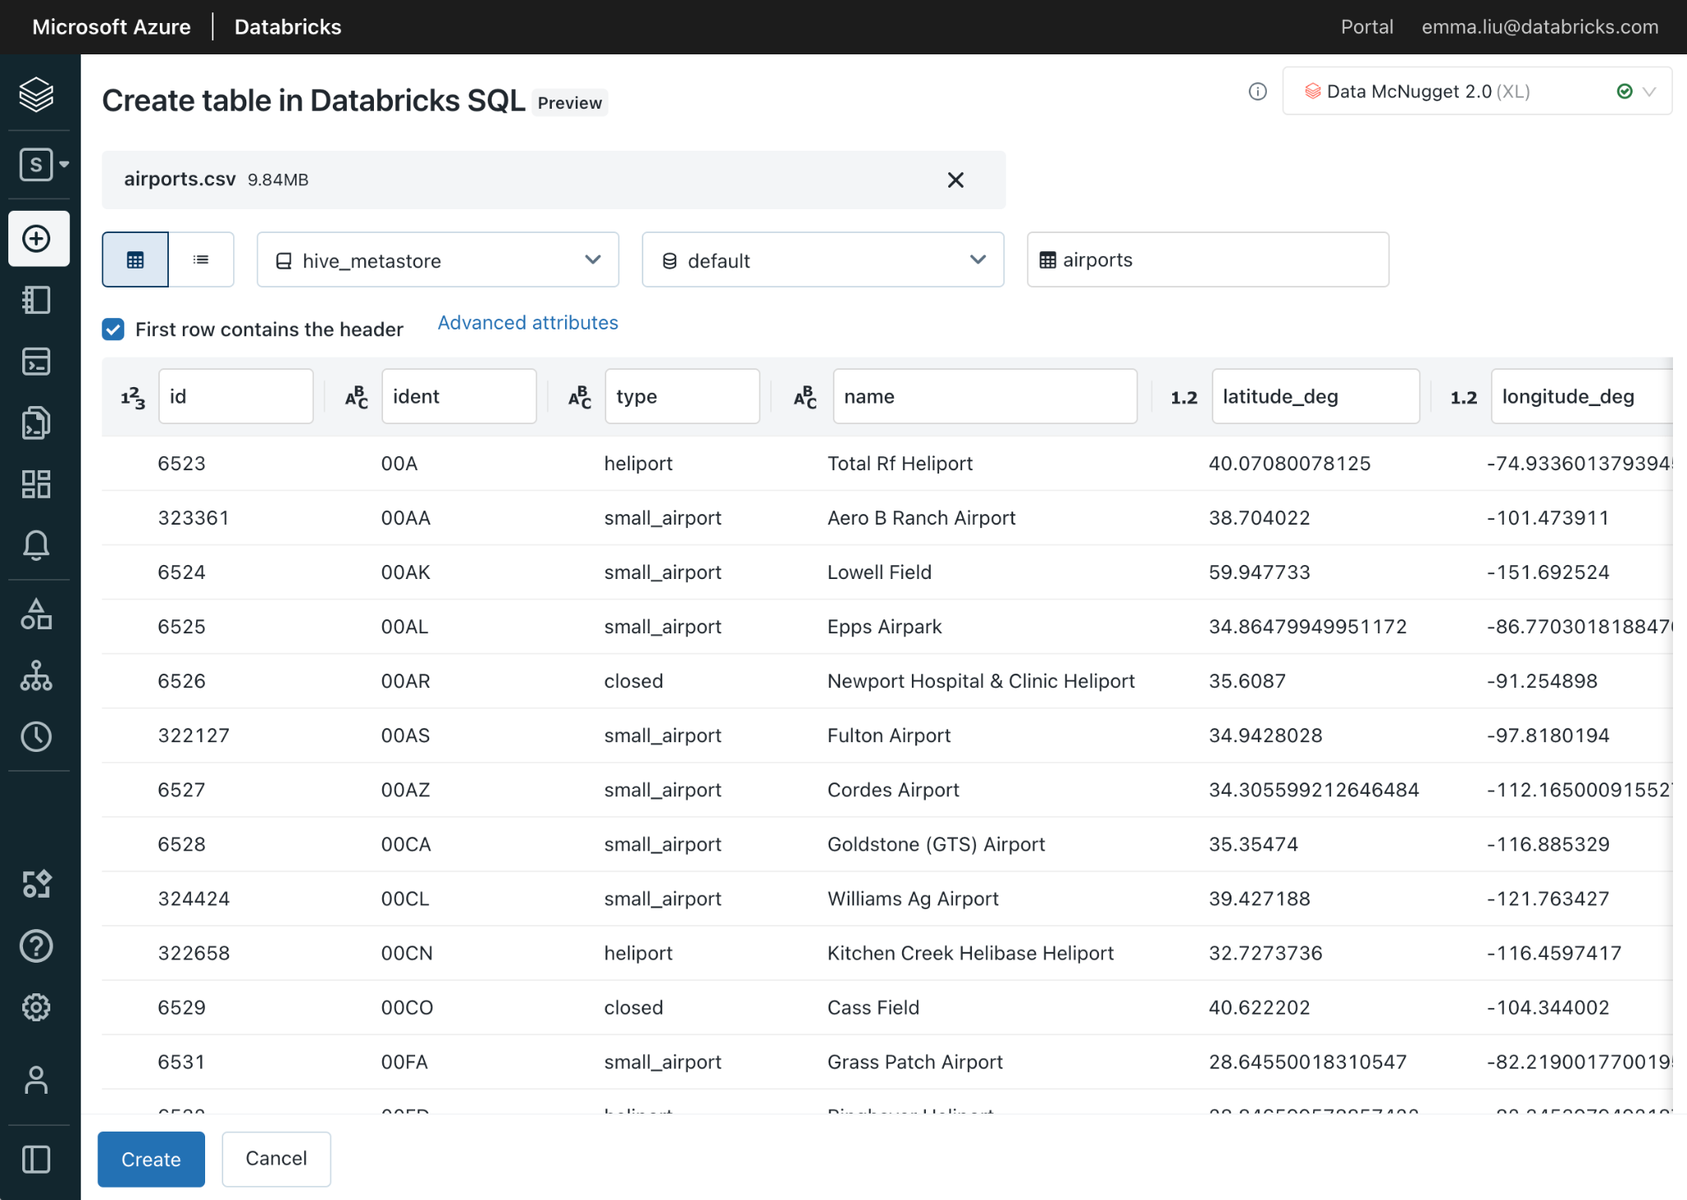

Data Ingestion: Fivetran
Work with your data no matter where it lives
Easily ingest business critical data from Salesforce, Google analytics, Marketo etc… using Fivetran or import files from your data stores.
+
Notes:
Work with your data, no matter where it is. Turnkey capabilities allow analysts and analytic engineers to easily ingest data from anything like cloud storage to enterprise applications such as Salesforce, Google Analytics, or Marketo using Fivetran. It’s just one click away.
Then, simply manage dependencies and transform data in-place with built-in ETL capabilities on the Lakehouse, or using your favorite tools like dbt on Databricks SQL for best-in-class performance.
Fivetran automated data integration adapts as schemas and APIs change, ensuring reliable data access and simplified analysis with ready-to-query schemas.

Slide 16

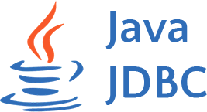

Data Consumption: Developer Ecosystem
Run SQL from anywhere and build custom data applications
Execute SQL statements over a REST API to access data managed by the Databricks Lakehouse Platform
Open Source Native Go & Node.js connectors with support for all the standard primitives and functionality
{REST:API}
Databricks SQL Warehouse
Notes:
SQL Execution API
The API provides access to data managed by the Databricks Lakehouse Platform by executing SQL statements over a REST API. This allows customers and partners to build data applications tailored to their needs. (PRD) Preview nomination form
GO & Node.js Connector
Providing native GO and Node.js interfaces for developing applications against DBSQL with support for all the standard primitives and functionality.
AWS / Azure / GCP
In Development
Private Preview (Q2)

Slide 17
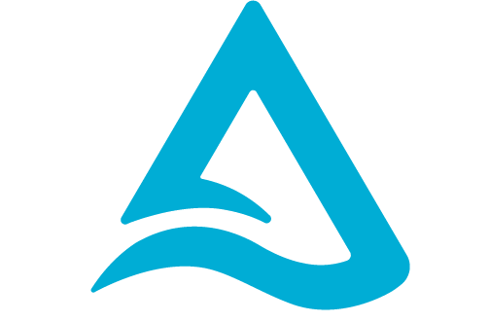








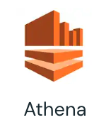





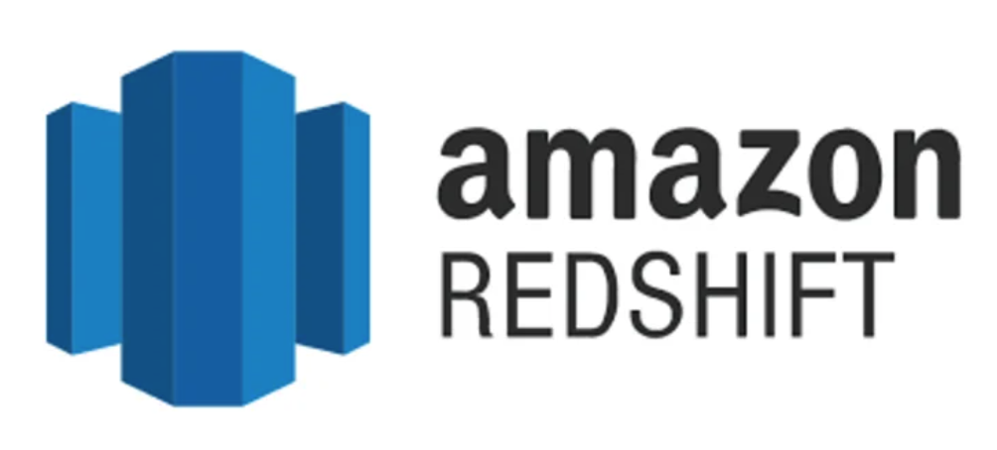



Delta Universal Format (Uniform)
Architecture
Databricks Notebooks, Delta Live Tables
Delta Lake
With UniForm
Curated Data
Metadata
Used for transactional source of truth, concurrency control, etc.
Metadata
UniForm
Data
All formats use Parquet!
Parquet
BRONZE
SILVER
GOLD
Read Delta as Iceberg
Microsoft
Fabric
Raw Ingestion and History
Filtered, Cleaned, Augmented
Business Aggregates & Data Models
Connector Ecosystem

Slide 18
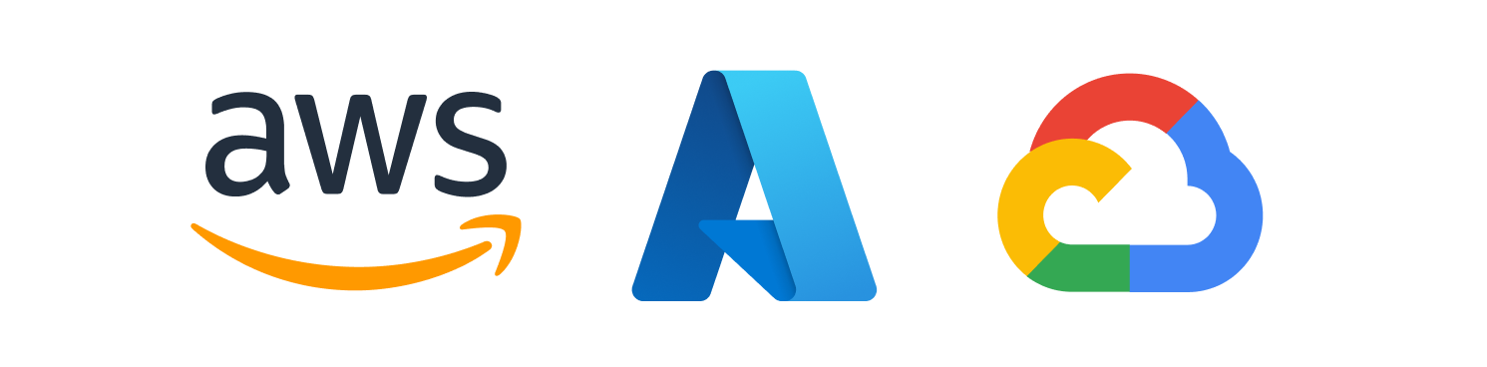
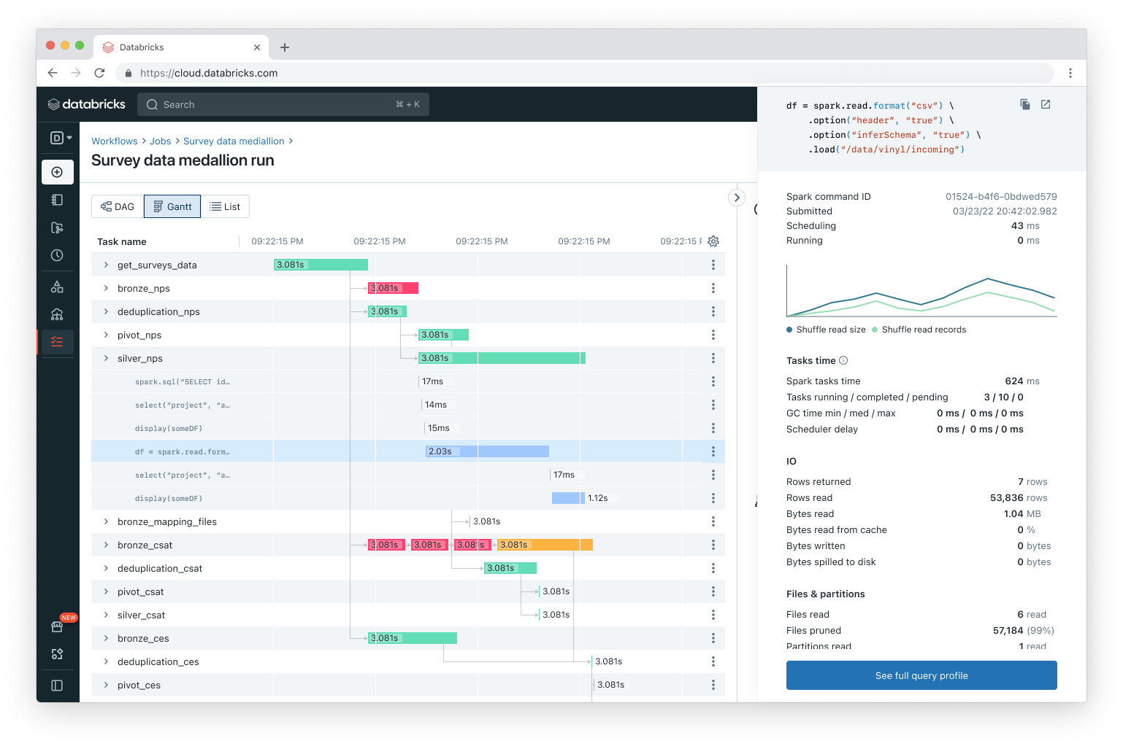
Gantt view of task execution
Improved observability for job runs
New view for job runs allows better visualization of workflow DAGs for troubleshooting and optimizations
Easily understand non-trivial workflow runs
Find workloads optimization opportunities
Diagnose and retry failed or slow tasks
GA in Q1
*Also available in AWS GovCloud
Databricks Confidential
Notes:
Observibility remains an important part of Databricks Workflows and we continuously invest in bringing more experiences that allow our customers to get actionable insights regarding their workflows and how each job runs. We are adding an exciting new visualization to Workflows which is especially useful for non-trivial jobs with multiple tasks. This Gantt view will let you see each job run with the various dependencies and you’ll be able to easily identify which tasks in a job run slowly and where you might have opportunities to optimize.

